Slide 1
Discriminative Stimulus and Motivating Operation
Manwei Cao
10/08/19
Notes:
Today I will lead you guys to go over some basic terms and definition over the concepts of Discriminative stimulus and motivating operation; then I will ask you guys to consider a specific real-life scenario, and to see if you guys can successful identity the elements we learned in classes.

Slide 2
Defining discriminative stimulus (sd)
Definition: antecedent stimulus correlated with the availability of reinforcement of a particular behavior
S-delta: the absence of SD
Notes:
first lets start with the concepts; here's the concept of discriminative stimulus

Slide 3
SD IN Negative reinforcement
Avoidance contingency
A response prevents or postpones the presentation of an aversive stimulus
Special tone before bright light → press lever → light postpone
SD →EO → R → Aversive Stimuli prevented/postponed
Discriminated avoidance
Responding in the presence of a signal (SD) prevents the onset of a stimulus from which escape is a reinforcer
Notes:
Special tone function as an SD because reinforcer would only be contingent to behavior in its presence; S-delta would not lead to reinforcer, so that the tone signals the availability of reinforcement; and at the same time, MO of avoiding the bright light (which is the aversive stimuli) is high no matter the tone is present or not

Slide 4
Defining motivating operations
Definition: alter the current effectiveness of stimulus changes as reinforcement
Two effects on behavior
Value-altering effects: an increase/decrease in the reinforcing effectiveness of some stimulus/object/event – Establishing Operation or Abolishing Operation
Behavior-altering effects: an increase/decrease in the current frequency of behavior that has been reinforced by the stimulus/object/event in the past – evocative effect or abative effect
Notes:
other aspect of behavior such as response magnitude, latency, and relative frequency (occurrence per opportunity) can be altered

Slide 5
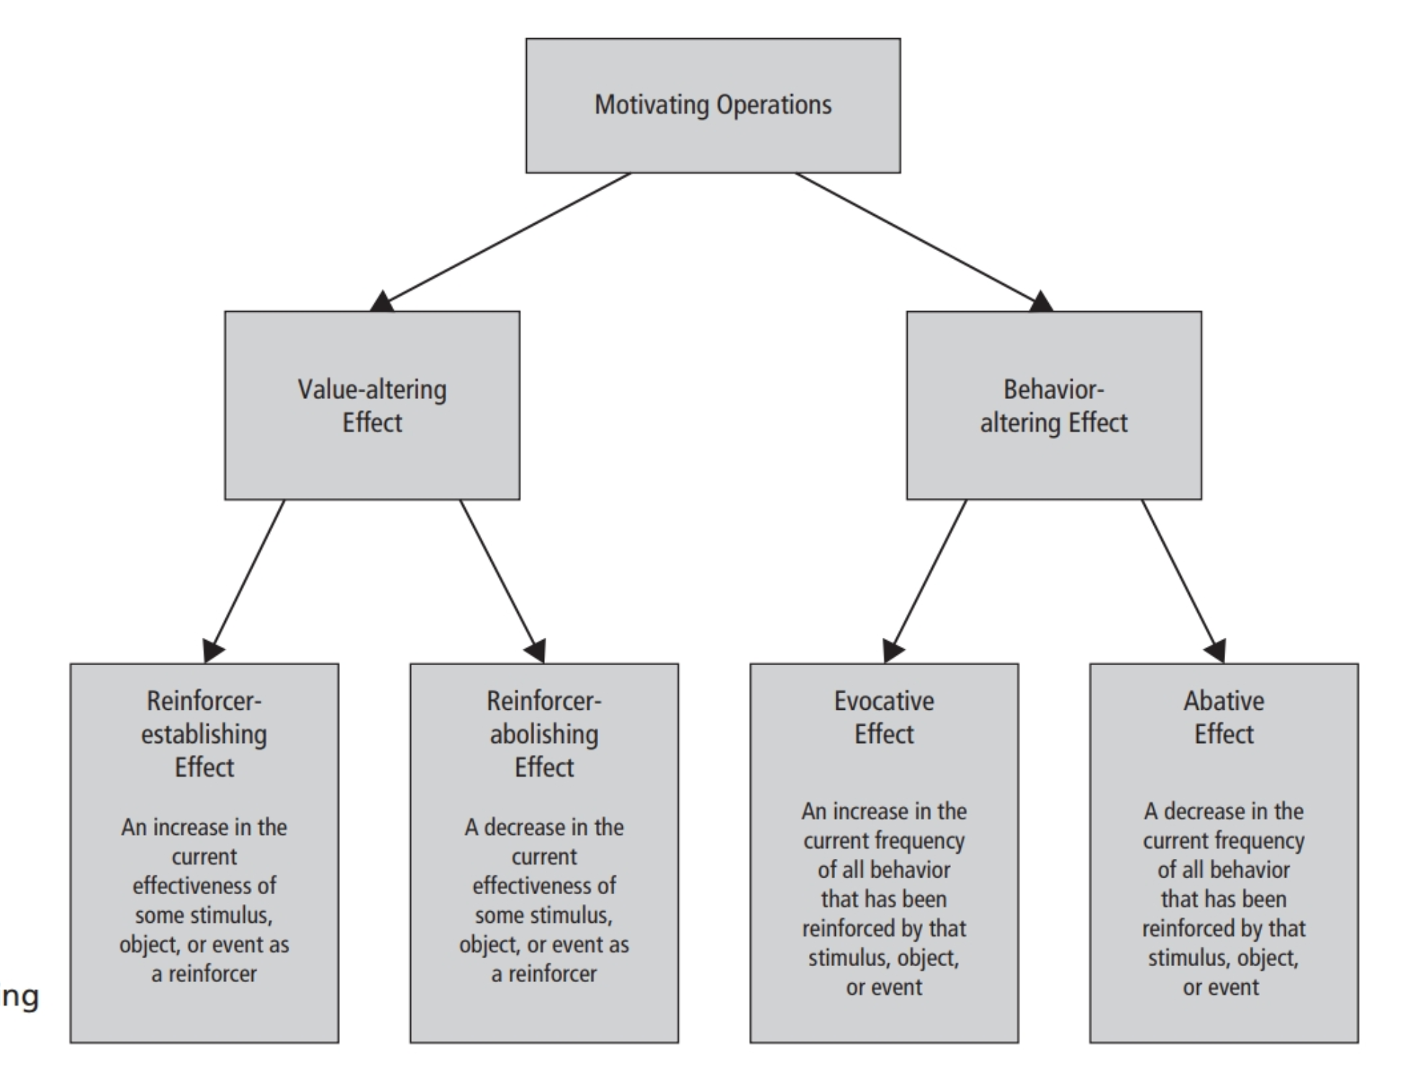

Slide 6
Examples of establishing operation
Painful stimulation → EO
(A) Increases the effectiveness of pain reduction as a reinforcer (value-altering)
(B) evokes all current behavior that has been reinforced by pain reduction in the past (behavior-altering)
food deprivation → EO
(A) increases the reinforcing potency of food (value-altering)
(B) increases current behaviors that have been previously reinforced by food/prior to obtaining any food (behavior-altering)

Slide 7
Direct and indirect effects of MO
Strong MOs can directly evoke behaviors in absence of SD – no prior learning history
Ex. Asking strangers for food (untrained stimuli)
MOs affect the strength of relevant SDs
Stronger EO increases the strength of SD
EO: food deprivation
SD: Sight of a friend who usually has snack in her backpack
The hungrier you are, the more likely you’re going to ask the friend for snacks!
Notes:
SD does not affect MO!

Slide 8
Direct and indirect effects of MO: Conclusion
Discrimination learning is unlikely to occur with out MO; EO is necessary for the establishment of three-term-contingency

Slide 9
MO VS. SD
SD | MO
Differential availability of reinforcer; Tells you if something is available | Differential effectiveness of reinforcer; Makes you want something
SD – reinforcer available S-delta – reinforcer unavailable | EO – reinforcer effective AO – reinforcer ineffective
Behavior decrease because reinforcer is no longer available | Behavior decrease because reinforcer is no longer valuable
S-delta → Extinction procedure | AO → Not motivated to perform the behavior
Example: rat no longer press lever in the absence of the bell ring | Example: food deprivation, pain stimulation, headache
Notes:
Extinction: make reinforcement no longer available contingent to a target behavior
example: only when lever is being pressed in the presence of the bell ring, food reinforcer will be delivered.

Slide 10
Now lets look at the scenario!
My friend Lily has been working with her 5 years old client Ana for a months now. However, starting last week, whenever Lily entered Ana’s home for a session, the moment Ana saw her, Ana would start running around the house, ignoring Lily’s demand “come sit at the table”….
Can you identify the behavior/response, MO, SD, reinforcement/punishment contingency in this scenario?
Notes:
The reason why I am doing this presentation today is because a month ago, my good friend who was preparing for her BCBA exam, called me to ask for my help on distinguishing between SD and MO. Here is the scenario we had trouble with:

Slide 11
Hint: we should look at this scenario from both the past and the present

Slide 12
What happened In the past
Lily showed up at Ana’s house
Lily demanded Ana to sit by the table and started DTT trials
Ana participated in DTT tasks while sitting at the table, produced wrong answer
Reprimand/extended trials contingent on incorrect response
SDP/SP
Behavior
punishment

Slide 13
What happens now
Lily shows up at Ana’s house
Ana starts running around the house
Session postponed/aversive stimulus postponed
CMO-R
Behavior
Negative reinforcement
Notes:
CMO = conditioned MO

Slide 14
Last things about MO
Surrogate CMO (CMO-S)
Sight of restaurant paired with hunger → evoke behavior of ordering food
Reflexive CMO (CMO-R)
Stimulus paired with painful stimulation; offset of the stimuli functions as reinforcer; stimuli evokes avoidance response
Transitive CMO (CMO-T)
Environmental variable establishes the effectiveness of another event as reinforcer/punisher

Slide 15
CMO-T (establishing stimulus)
UMO/CMO-T
Hunger
SD
Sight of waiter
Response 2
Order food
Wave to waiter
Response 1
Consequence 2
Waiter comes over
Get food
Consequence 1
Notes:
Hunger is the CMO-T because established the reinforcing effect of consequence 2 – waiter come over, and thus evoked the behavior of wave to waiter

Slide 16
Work cited
Applied Behavior Analysis, 3rd Edition, Chapter 13-17. John O. Cooper, Timothy E. Heron, William L. Heward.
Distinguishing Between Discriminative and Motivational Functions of Stimuli. Jack Michael. First published: January 1982
https://doi.org/10.1901/jeab.1982.37-149

